Slide 1
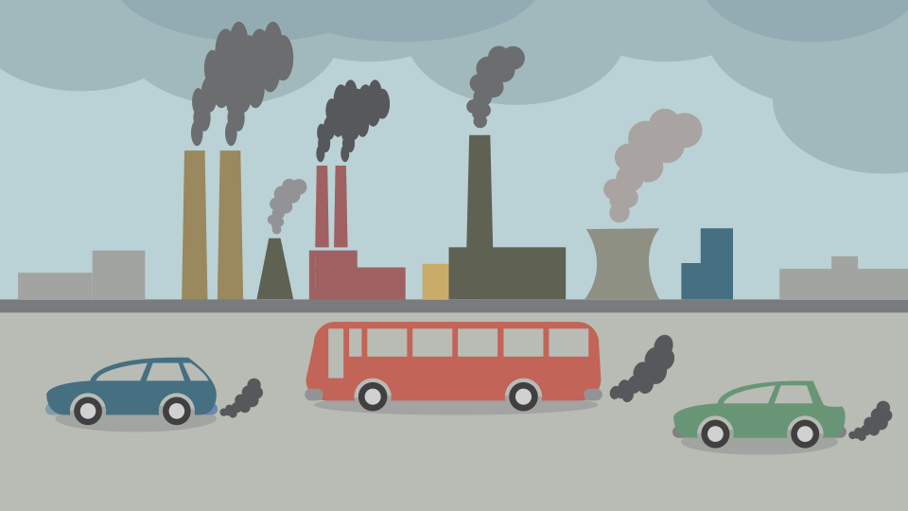

Air Quality Index Prediction Using Machine Learning
Presented by:
Pallavi Singh - 1JT15CS034
Yashashwini R - 1JT16CS061
Under the guidance of :
Srinidhi Kulkarni Asst. Professor CSE,JIT
Saravana M K Asst. Professor CSE, JIT

Slide 2
Table Of Contents
Introduction
Data Flow Diagram – Level 0
Data Flow Diagram – Level 1
Data Flow Diagram – Level 2
Flow Chart

Slide 3
Introduction
Air pollution causes conspicuous damage to the environment as well as to human health resulting in acid rain, heart diseases, global warming and skin cancer to all humankind.
Urbanized Air quality monitoring has been a constant challenge with the advent of industrialization.
It is aimed to predict the Air Quality Index (AQI) by the use of Machine learning algorithms.
To reach this, the key parameters have been selected which can affect the Air quality index are temperature, humidity, pressure, wind speed, PM10 and SO 2 respectively.

Slide 4
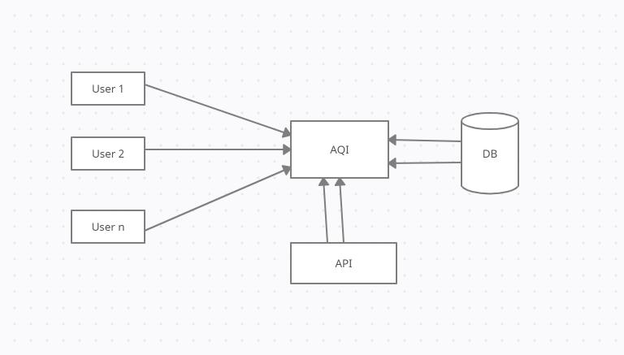
Data Flow Diagram Level- 0
*

Slide 5
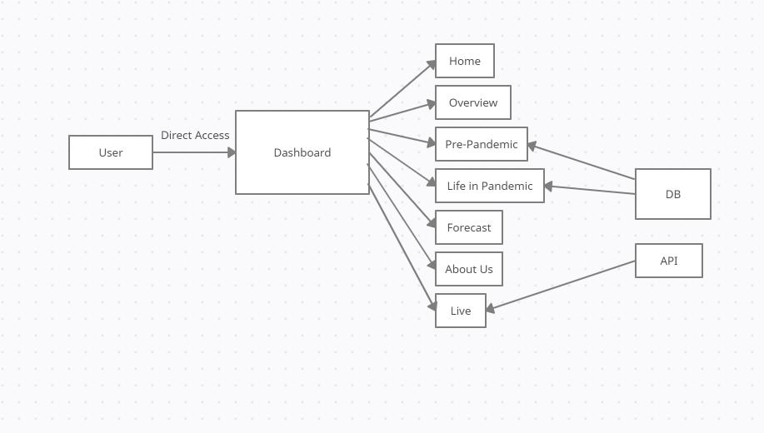
Data Flow Diagram Level- 1

Slide 6
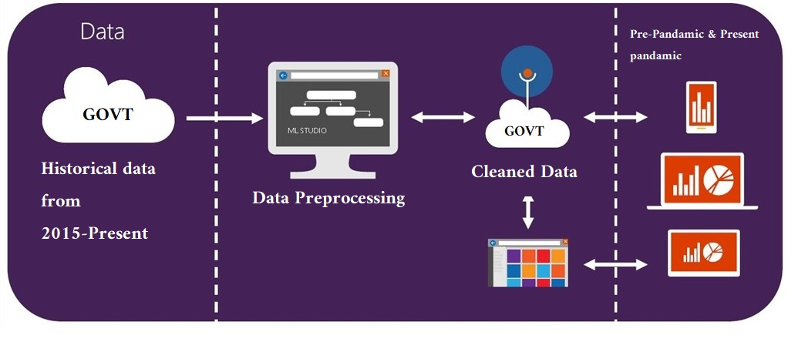
Data Flow Diagram Level- 2 Pre -Pandamic and life in Pandamic module

Slide 7
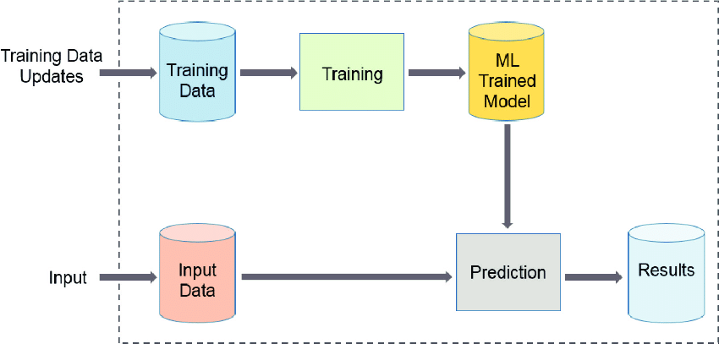
Forecast module

Slide 8
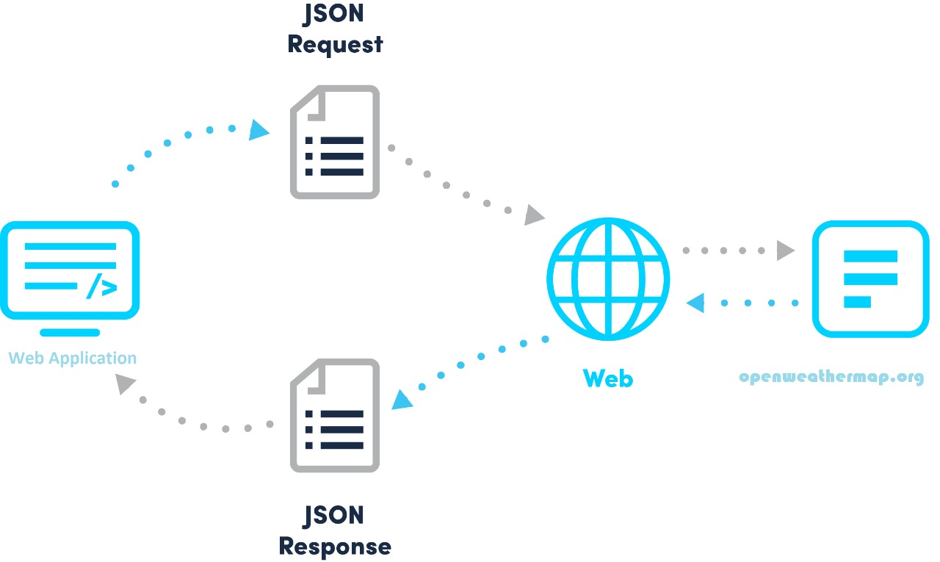
Live module

Slide 9
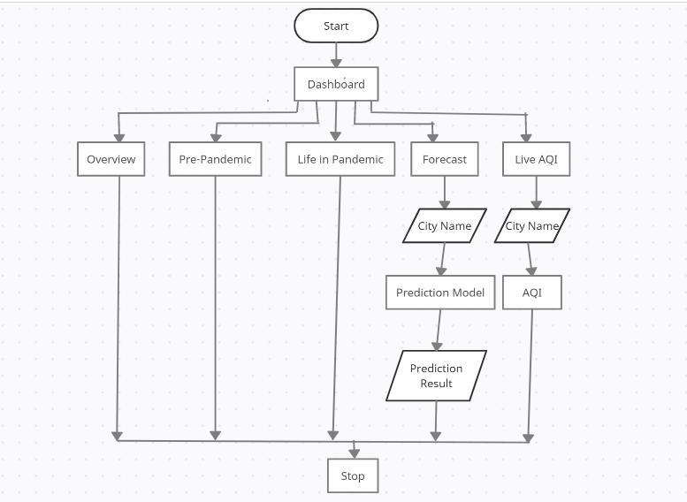
Flowchart

Slide 10
Thank you

